Slide 1
BOOK ANALYTICS USING DATA SCIENCE End-to-End Data Science Capstone Project
Prepared By:Ritesh Redekar
Domain:Book Analytics
Dataset Source:Open Library API
Tools Used:
Python,Pandas,NumPy,Matplotlib,Scikit-Learn,Power BI

Slide 2
Project Objective:
Objective
The objective of this project is to collect real-world book data from the Open Library API and transform it into meaningful business insights using Data Science techniques.
This project includes:
Web ScrapingData CleaningFeature EngineeringExploratory Data AnalysisMachine Learning ClassificationInteractive Power BI Dashboard

Slide 3
Workflow:
Project WorkflowOpen Library API
↓
Web Scraping
↓
Raw Dataset
↓
Data Cleaning
↓
Feature Engineering
↓
Exploratory Data Analysis
↓
Machine Learning
↓
Power BI Dashboard

Slide 4
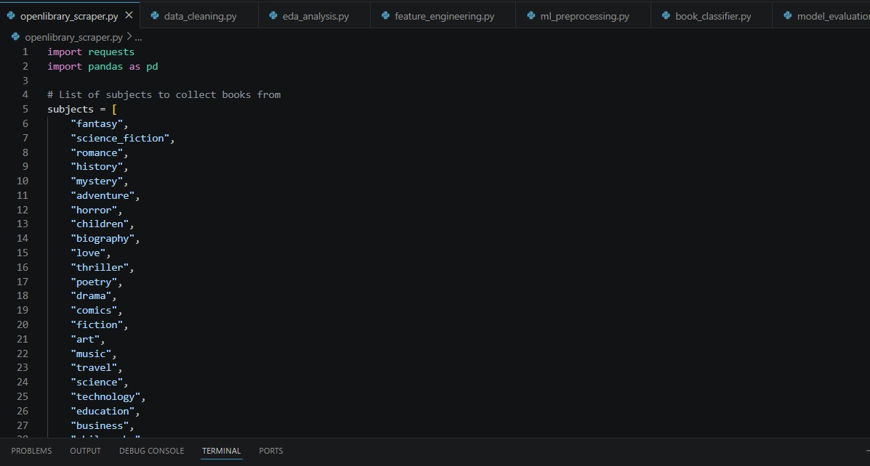
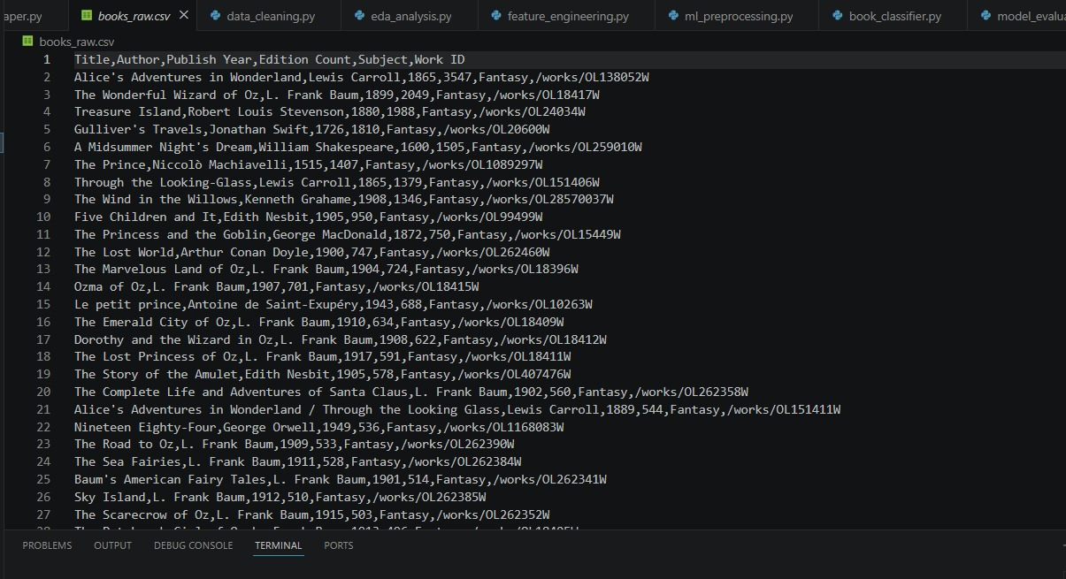
Web Scraping:
Data Collection
Book data was collected using the Open Library REST API.
Python libraries used:
Requests
Pandas
Collected information:
Title
Author
Subject
Publish Year
Edition Count
Work ID
Total Records Collected
1877 Books

Slide 5
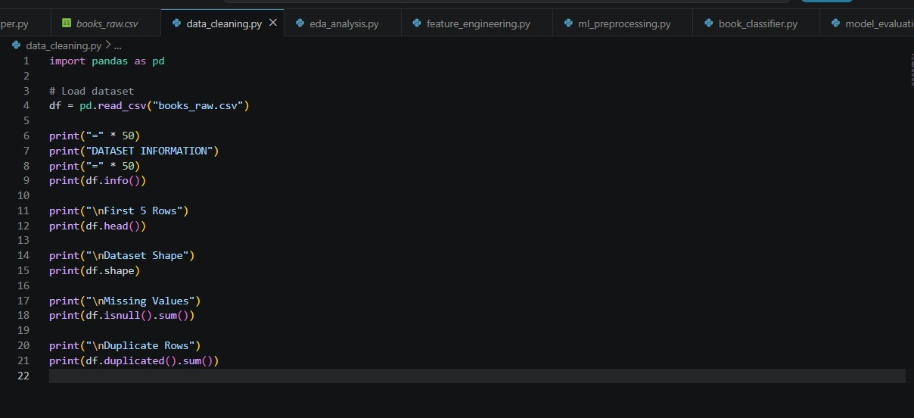
Data Cleaning & Feature Engineering:
Data Cleaning
Performed:
Removed missing values
Removed duplicates
Converted data types
Standardized text
Created new features
New Features Created
Book Age
Publication Decade
Edition Category
Data_cleaning.py

Slide 6
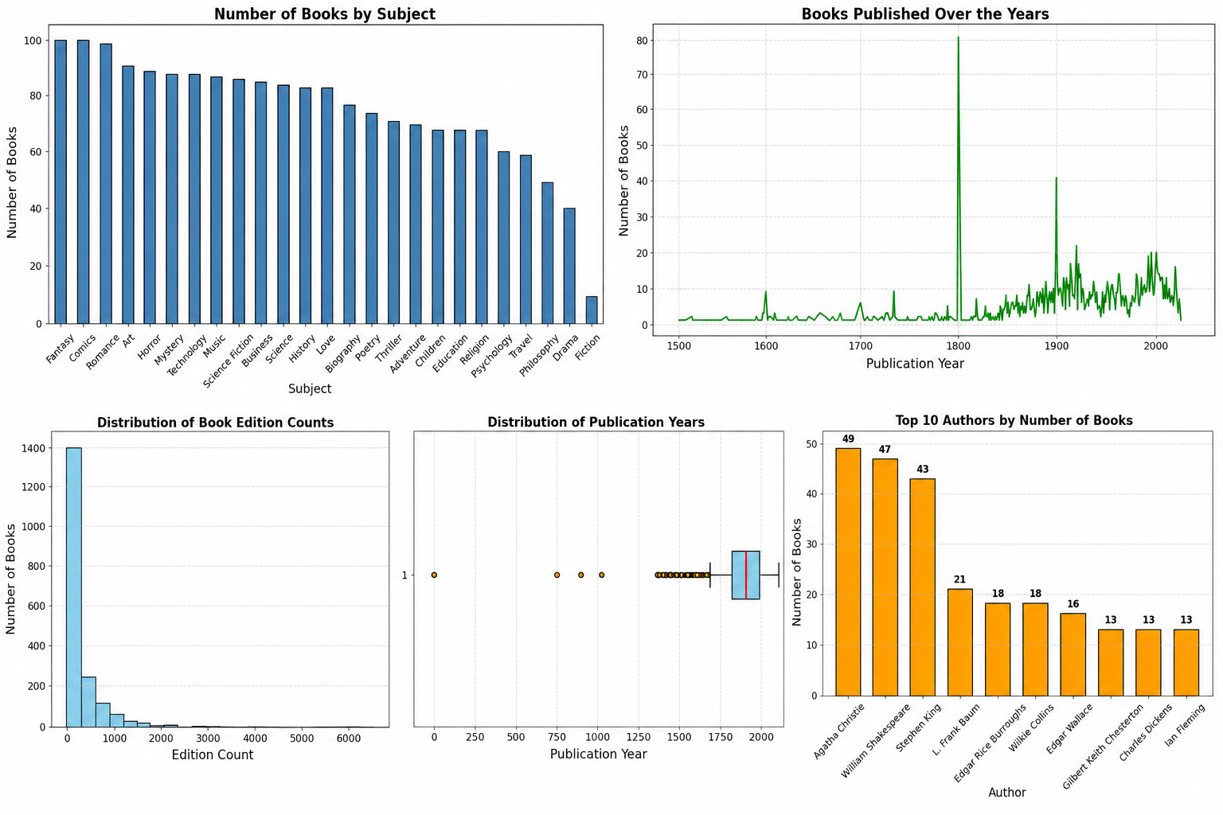
Exploratory Data Analysis:
EDA
Several visualizations were created to identify trends.
Visualizations:
Books by Subject
Books by Publication Year
Publication Year Box
plotTop Authors
Edition Count Distribution
Key Findings
Romance and Fantasy are highly represented.
Most books were published after 1950.
Few authors contribute many books.
Edition Count varies significantly.

Slide 7
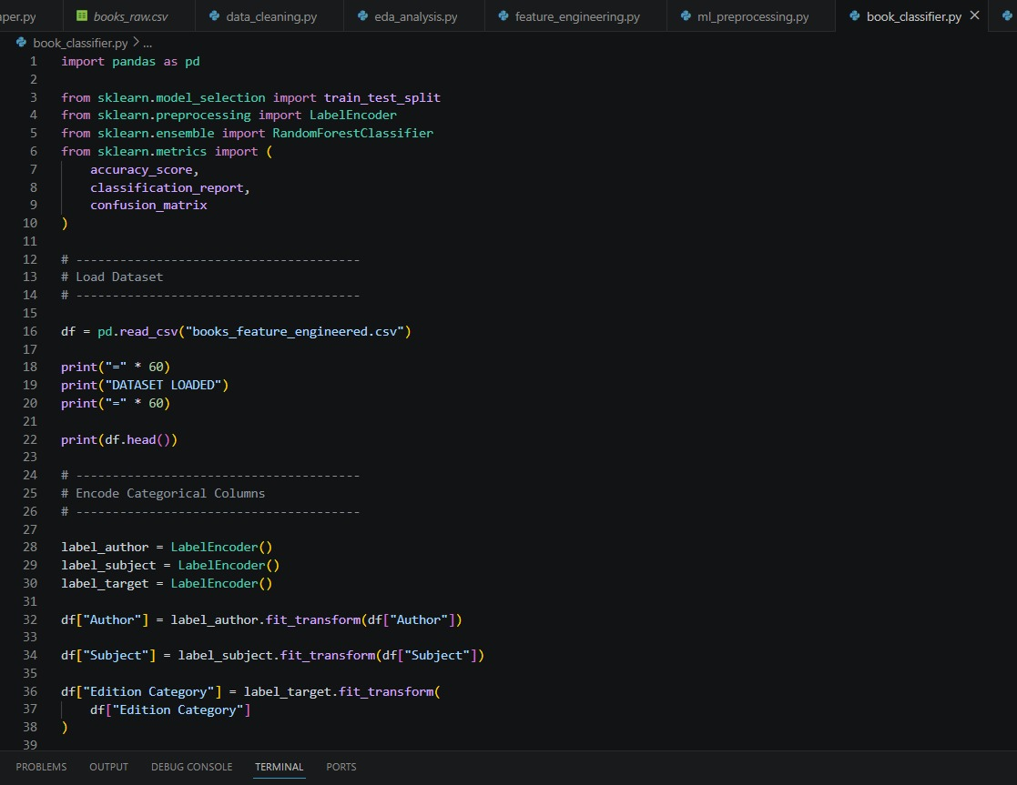
Machine Learning:
Book_classifier.py
Model Building
Problem Type
Classification
Target Variable
Edition Category
Algorithm Used
Random Forest Classifier
Train-Test Split
80 : 20
Libraries
Scikit-Learn

Slide 8
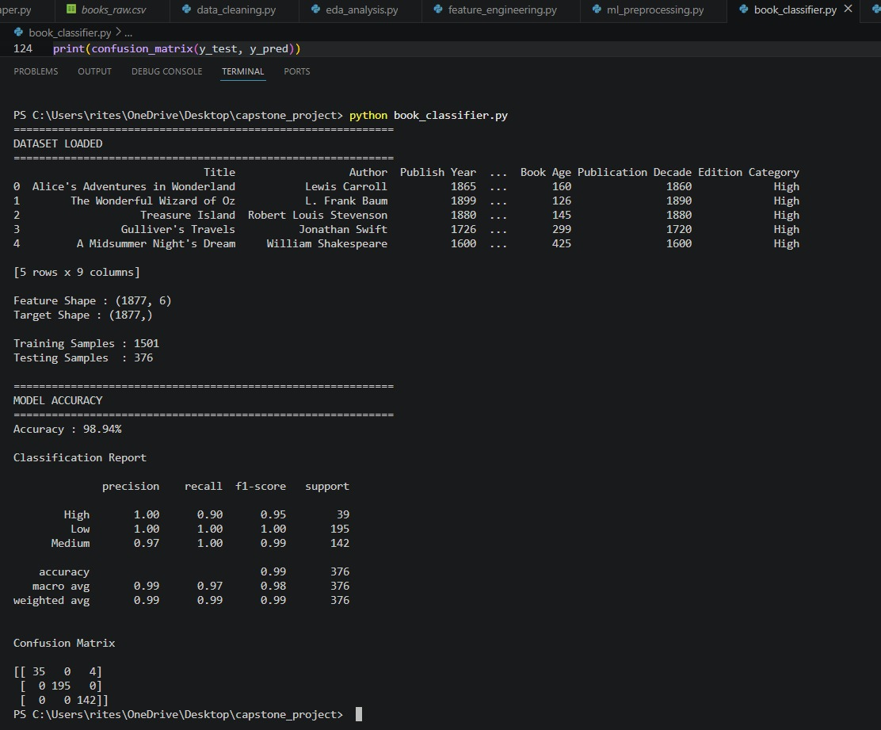
Model Evaluation:
Terminal_output:
Model Performance
Training Samples:
1501
Testing Samples:
376
Accuracy:
98.94%
Classification Metrics
Precision
Recall
F1 Score
Confusion Matrix Generated

Slide 9
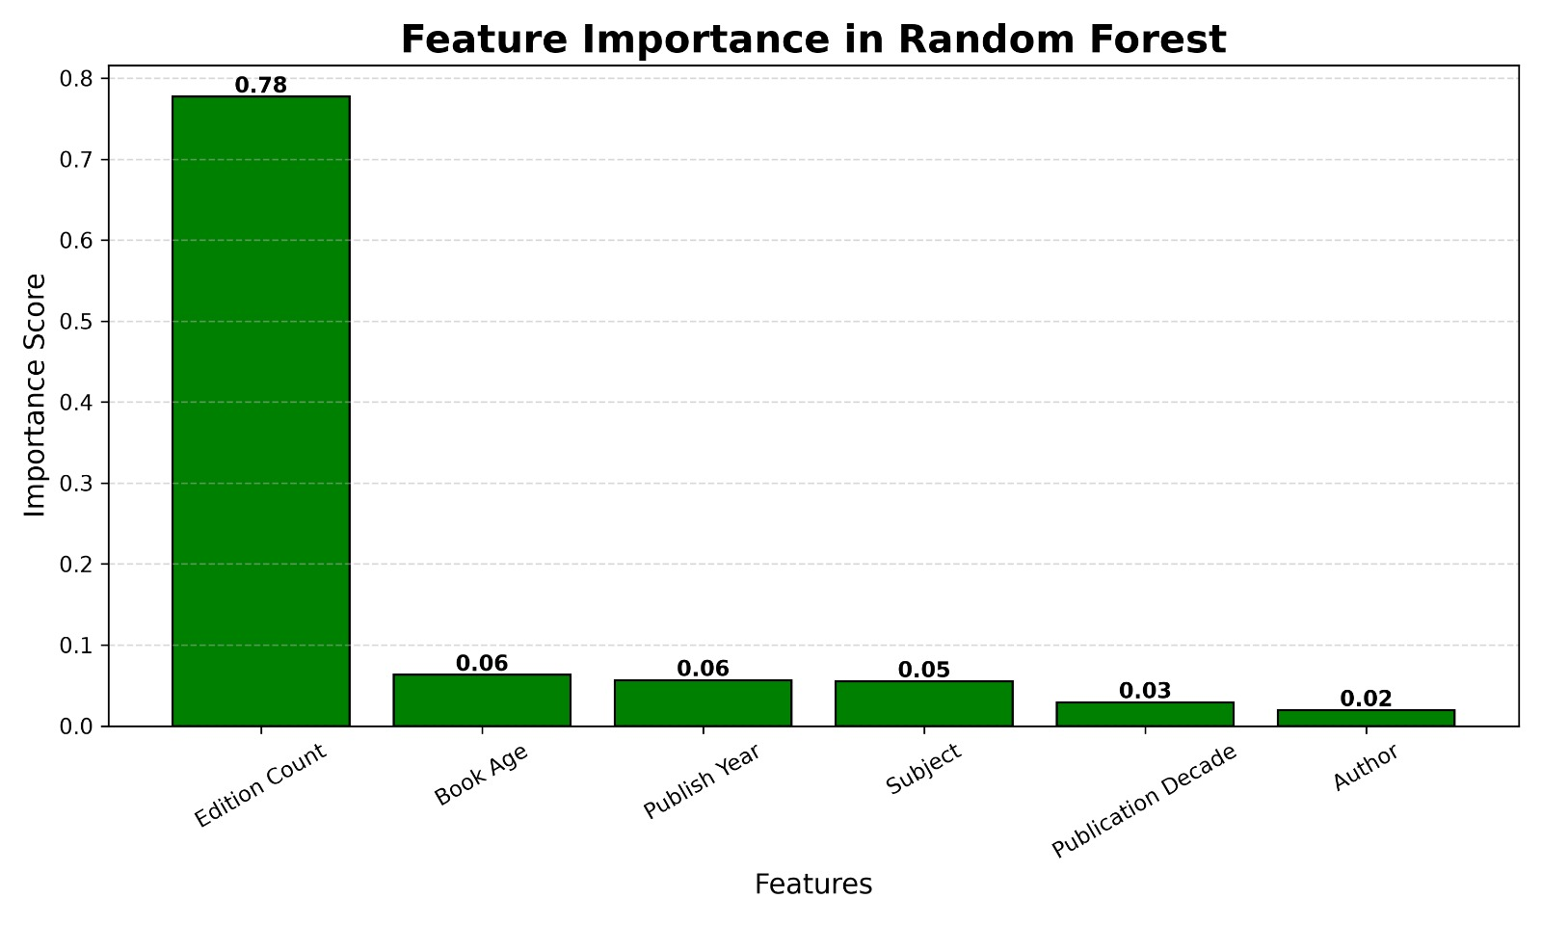
Feature Importance:
Feature Importance
Random Forest identified the most important features.
Ranking
1 Edition Count
2 Book Age
3 Publish Year
4 Subject
5 Publication Decade
6 Author
Observation
Edition Count contributes nearly 78% towards prediction

Slide 10
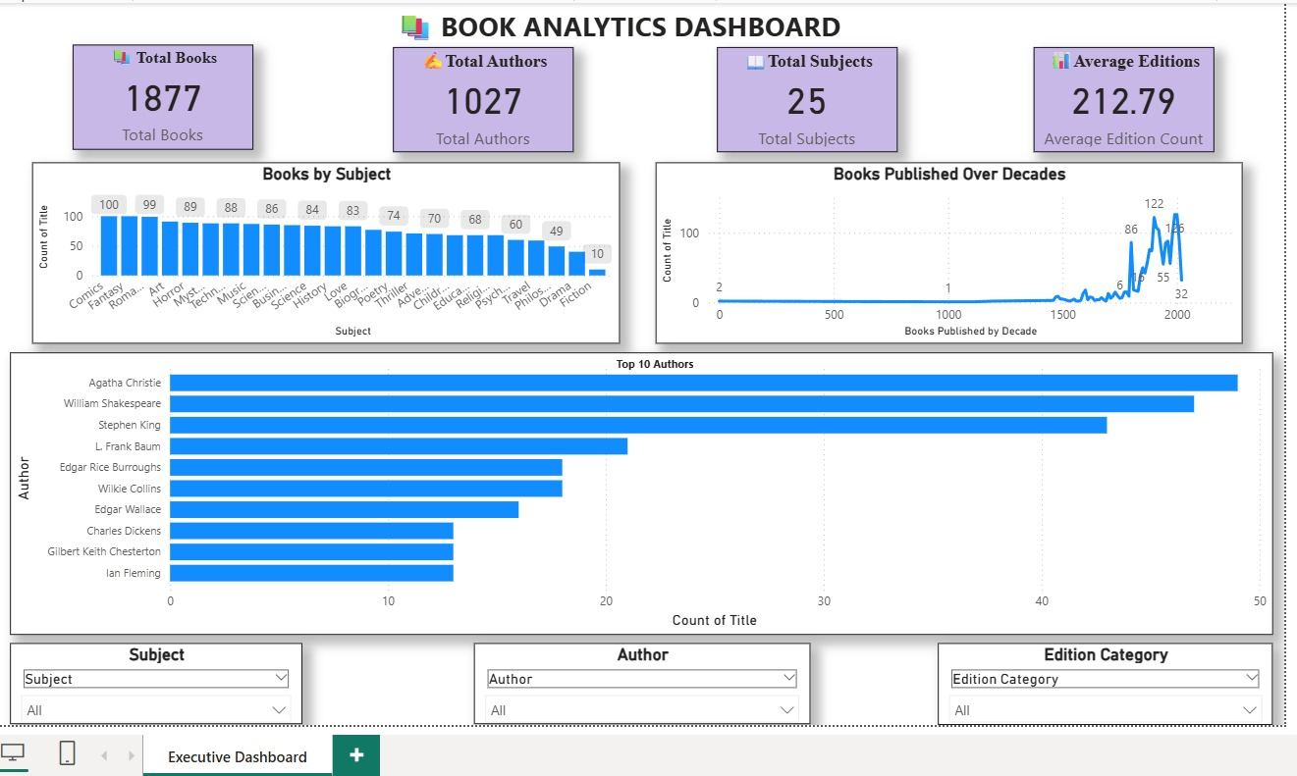
Power BI Dashboard:
Interactive Dashboard
Dashboard contains
KPIs
Total Books
Total Authors
Total Subjects
Average Editions
Charts
Books by Subject
Books Published Over Decades
Top 10 Authors
Interactive Filters
Subject
Author
Edition Category

Slide 11
Business Insights:
Key Insights
1877 books were analyzed.
More than 1000 unique authors exist.
Romance and Fantasy contain the highest number of books.
Book publication increased significantly after the 1950s.
Edition Count is the strongest predictor of Edition Category.
The Random Forest model achieved 98.94% accuracy

Slide 12
Conclusion:
Conclusion
The project successfully demonstrates an end-to-end Data Science workflow.
Achievements
✔️ Web Scraping
✔️ Data Cleaning
✔️ Feature Engineering
✔️ Exploratory Data Analysis
✔️ Machine Learning
✔️ Interactive Dashboard
The generated insights can help publishers and libraries understand publishing trends and book popularity.

Slide 13
Thank You & Video Submission:
THANK YOU
Prepared By:Ritesh Redekar
Project Demonstration Video
Video url: https://drive.google.com/file/d/1tec7h-P2rY07690xwnBXSNKjbrRtB5u1/view?usp=sharing

